Slide 1

The Originals
SSSS - 1813
Chandigarh University
Leader: Shruti Sharma
Members:
Vinit Kundu
Harshit Kumar
Anurag Rawat

Slide 2

CityWatch
A Comprehensive Surveillance and Analysis Platform for Smart Cities

Slide 3

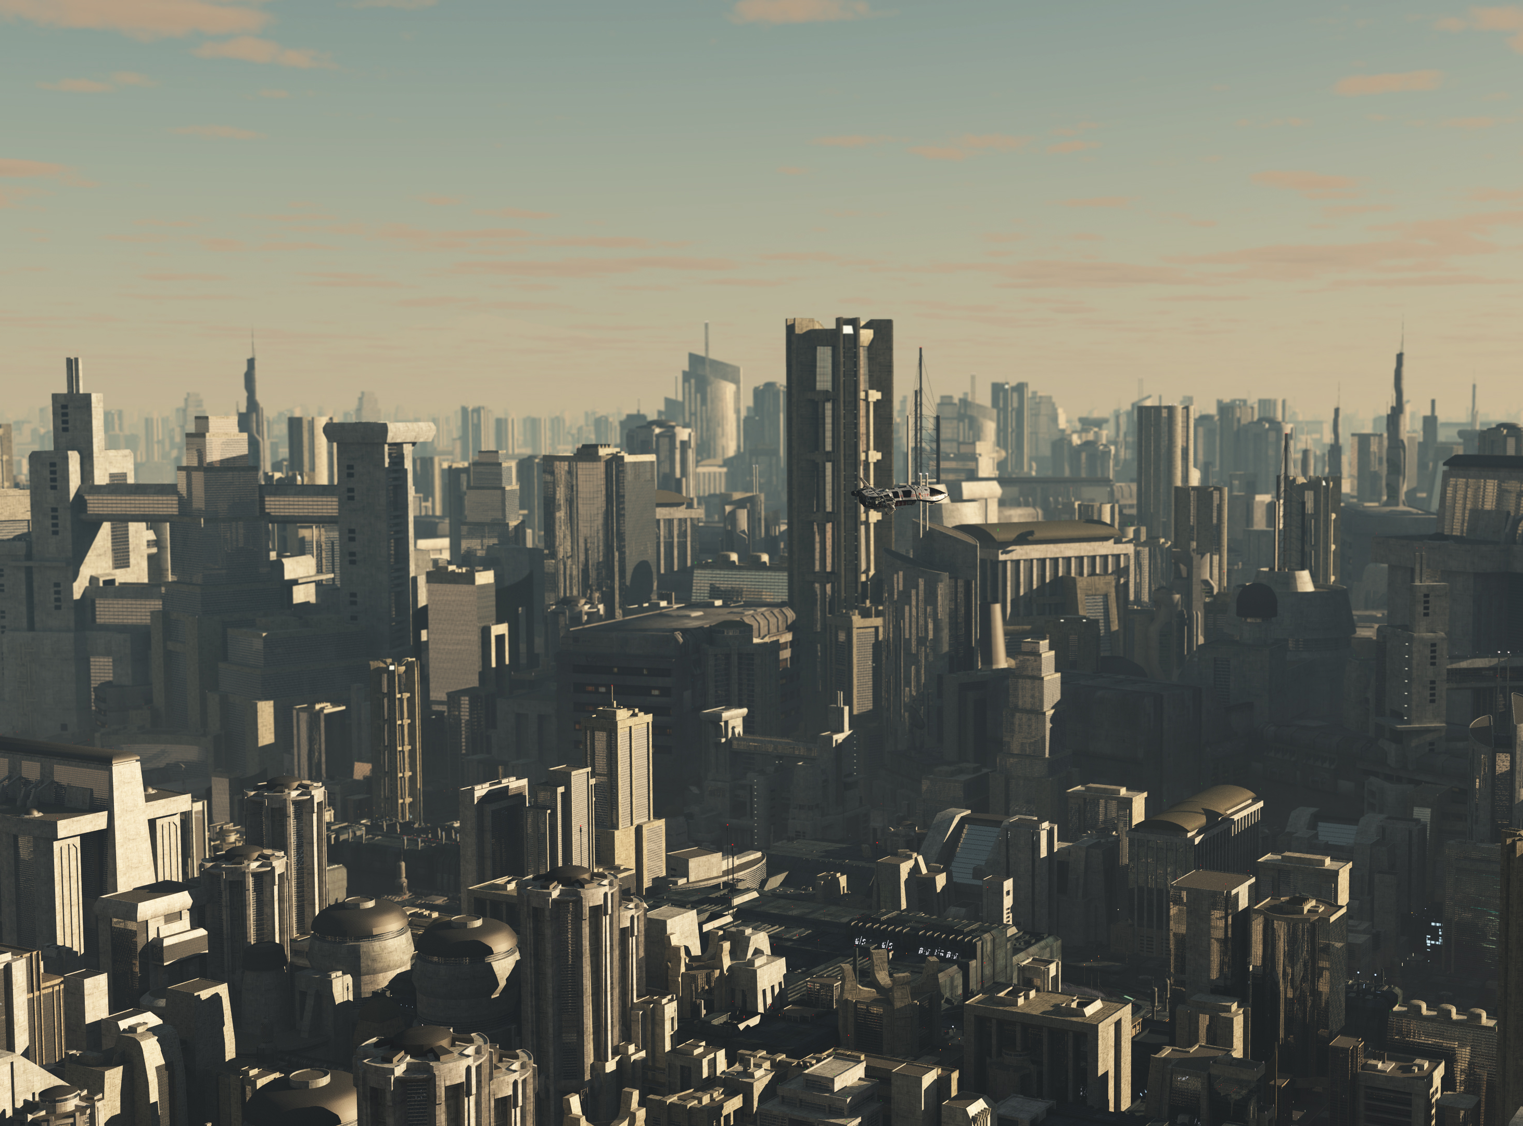
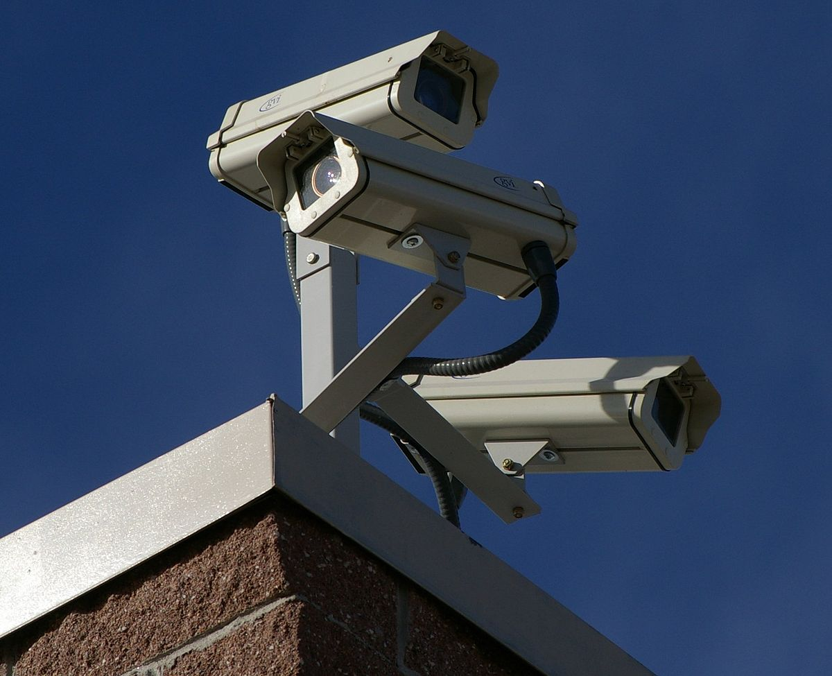
Problem Statement:
Cities today face a growing number of security challenges and risks, including crime, terrorism, and natural disasters. Traditional surveillance systems, such as CCTV cameras, are often limited in their ability to provide comprehensive surveillance coverage and real-time analysis of data. This can make it difficult for city officials and first responders to quickly identify and respond to potential security threats.

Slide 4
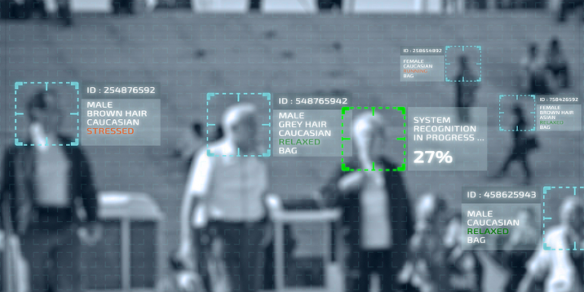
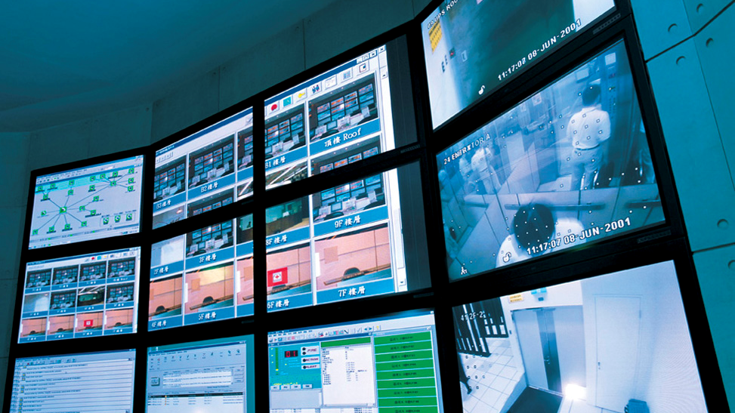
Solution
The goal of this project is to develop a software-based solution that integrates multiple data sources, such as CCTV cameras, social media, and weather sensors, to provide a real-time view of the city's surveillance status. The solution will use machine learning algorithms and computer vision techniques to analyze the data and detect patterns and anomalies that could indicate a security threat. The solution will also include a user-friendly interface that allows city officials and first responders to monitor and control the surveillance system in real-time, as well as replay and analyze footage from past events. The solution should also have the ability to generate real-time alerts and recommendations for city officials and first responders in case of emergency

